Slide 1
OOP152 – OBJECT-ORIENTED PROGRAMMING
2024

Slide 2
Topic 2 More complex methods

Slide 3
Control flow
OUTCOMES
Recursive methods
Value methods
Control flow constructs
Arrays and strings
Collection processing

Slide 4
Recursive methods

Slide 5
Control flow
Recursive Method
Introduction to Recursion:
Recursion occurs when a method calls itself.
Each call to itself is with a different argument until a base case is reached.

Slide 6
Control flow
Recursive Method
Example: Countdown Method
Code:
public static void countdown(int n) {
if (n == 0) {
System.out.println("Blastoff!");
} else {
System.out.println(n);
countdown(n - 1);
}
}

Slide 7
Control flow
Recursive Method
Execution Flow for countdown(3):
Starts at n=3 and counts down to 0.
Displays each number followed by "Blastoff!".
Example Output:
3
2
1
Blastoff!

Slide 8
Control flow
Recursive Method
Example: nLines Method
Code:
public static void nLines(int n) {
if (n > 0) {
System.out.println();
nLines(n - 1);
}
}

Slide 9
Control flow
Recursive Method
Purpose:
Displays n newlines.
Recursively calls nLines with n-1 until n is 0.
Advantages:
Flexible for any number of new lines compared to fixed methods.

Slide 10
Control flow
Recursive Method
Benefits of Recursive Methods:
Simplifies code by reducing the need for complex loops and conditionals.
Makes it easier to solve problems that naturally fit the recursive pattern, such as tree traversals and fractal designs.

Slide 11
Recursive stack diagram

Slide 12
Control flow
Recursive Stack Diagram
Introduction to Stack Diagrams
Stack diagrams represent the state of a program during method invocations.
Useful for visualizing the execution of recursive methods.

Slide 13
Control flow
Recursive Stack Diagram
Stack Frames in Recursive Calls
Each method call creates a new frame storing parameters and variables.
Example: Stack diagram for countdown method called with n == 3.

Slide 14
Control flow
Recursive Stack Diagram
Visualizing the Countdown Method
Stack grows downward, with main at the top.
Main’s frame is typically at the top and is empty if no variables are used.
Multiple frames for countdown, each showing different values of n.

Slide 15
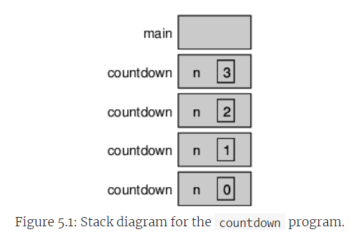
Control flow
Recursive Stack Diagram
Visualizing the Countdown Method

Slide 16
Control flow
Recursive Stack Diagram
Understanding the Base Case
The base case prevents further recursive calls (e.g., n == 0 in countdown).
Last frame in the stack (base case) does not call the method recursively.

Slide 17
Control flow
Recursive Stack Diagram
Consequences of Missing a Base Case
Without a base case, or if it's never reached, the stack grows indefinitely.
Leads to a StackOverflowError if the stack limit is exceeded.

Slide 18
Control flow
Recursive Stack Diagram
Example of a Recursive Method without a Base Case
public static void forever(String s) {
System.out.println(s);
forever(s); // Causes stack overflow due to endless recursion
}

Slide 19
Control flow
Recursive Stack Diagram
Conclusion
Importance of a base case in recursive functions to avoid StackOverflowError.
Stack diagrams are crucial tools for understanding recursive calls and managing program execution flow.

Slide 20
Binary numbers

Slide 21
Control flow
Binary Numbers
Introduction to Binary Number Calculation
Illustration of converting decimal numbers to binary by dividing the number by two.
Example: Convert 23 to binary
23 / 2 = 11 remainder 1
11 / 2 = 5 remainder 1
5 / 2 = 2 remainder 1
2 / 2 = 1 remainder 0
1 / 2 = 0 remainder 1
Read remainders from bottom to top, 23 in binary is 10111.

Slide 22
Control flow
Binary Numbers
Recursive Method to Display Binary
Explains a recursive approach to display binary representation of any positive integer.
public static void displayBinary(int value) {
if (value > 0) {
displayBinary(value / 2);
System.out.print(value % 2);
}
}

Slide 23
Control flow
Binary Numbers
Base Case: When value is zero, displayBinary does nothing.
Recursive Case: Divides value by two, calls displayBinary recursively, and then displays the remainder when value is divided by two.
Execution Flow:
Recursive calls build the call stack, pushing smaller divisions to the stack.
Remainders are printed in the order they are popped off the stack (from bottom to top).

Slide 24
Control flow
Binary Numbers
Code Execution Example:
Demonstrates usage of displayBinary with an example:
displayBinary(23);
System.out.println(); // Output: 10111

Slide 25
Control flow
Binary Numbers
Key Takeaway:
Recursive functions can be used effectively to compute results in reverse order, which is useful in binary number computation.
Learning recursive methods is crucial for developing a computational thinking approach, allowing concise and powerful expression of algorithms.

Slide 26
Exercises

Slide 27
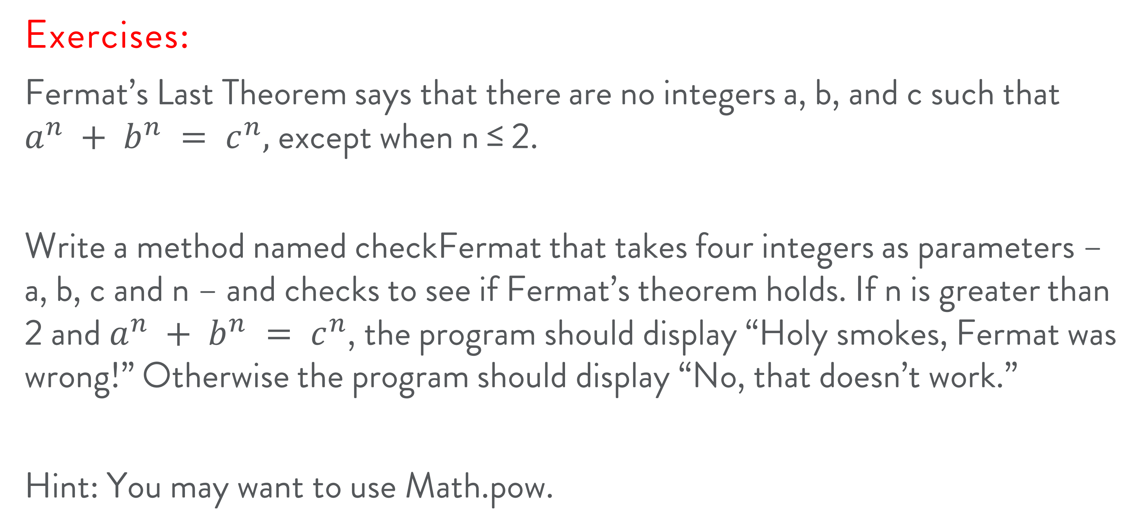
Control flow
Exercises:
Fermat’s Last Theorem says that there are no integers a, b, and c such that $a^{n} + b^{n} = c^{n},$ except when n ≤ 2.
Write a method named checkFermat that takes four integers as parameters – a, b, c and n – and checks to see if Fermat’s theorem holds. If n is greater than 2 and $a^{n} + b^{n} = c^{n}$, the program should display “Holy smokes, Fermat was wrong!” Otherwise the program should display “No, that doesn’t work.”
Hint: You may want to use Math.pow.

Slide 28



